Slide 1

Goodcabs Performance Analysis
Presented By
Denis M

Slide 2
AZENDA
1. Company Overview
2. Dashboard Preview
3. Primary Questions and Insights
4. Ad-hoc Reports
5. Secondary Analysis
6. Recommendations

Slide 3
COMPANY OVERVIEW
Goodcabs, a cab service company established two years ago, with a strong foothold in the Indian market by focusing on tier-2 cities.
Goodcabs is committed to supporting local drivers, helping them make a sustainable living in their hometowns while ensuring excellent service to passengers.
With operations in ten tier-2 cities across India, Goodcabs has set ambitious performance targets for 2024 to drive growth and improve passenger satisfaction.
Goodcabs management team aims to assess the company’s performance across key metrics, including trip volume, passenger satisfaction, repeat passenger rate, trip distribution, and the balance between new and repeat passengers.

Slide 4
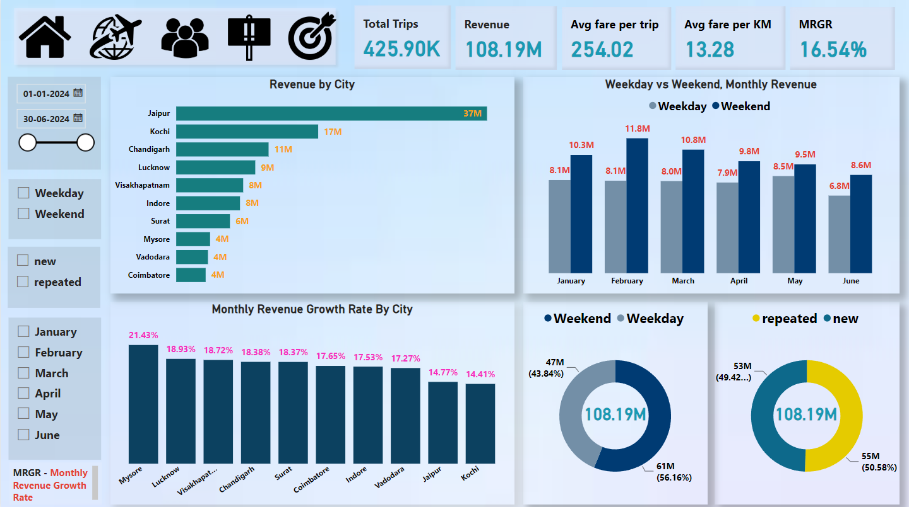
Revenue Overview
DASHBOARD PREVIEW

Slide 5
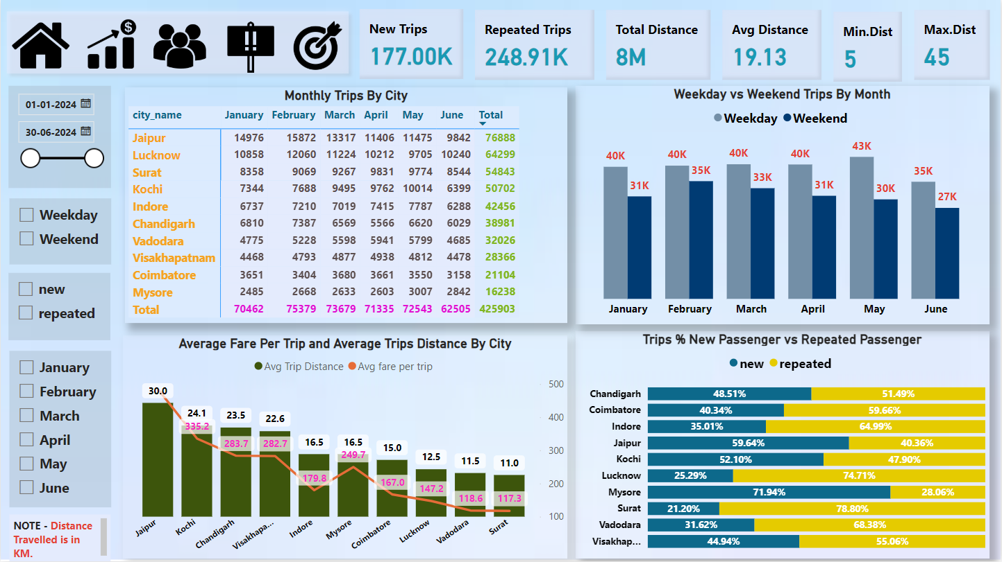
Trips Overview

Slide 6
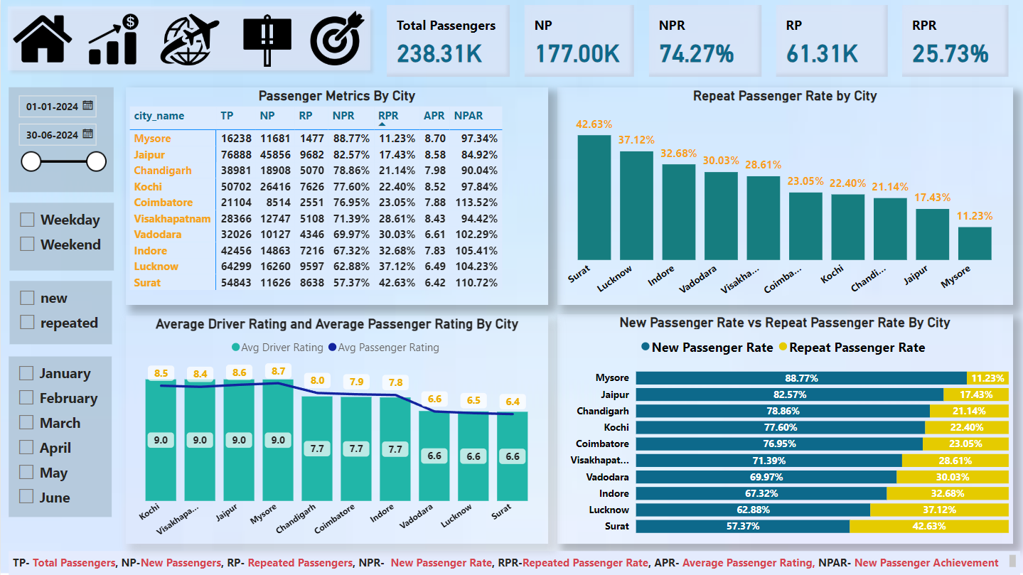
Passenger Performance

Slide 7
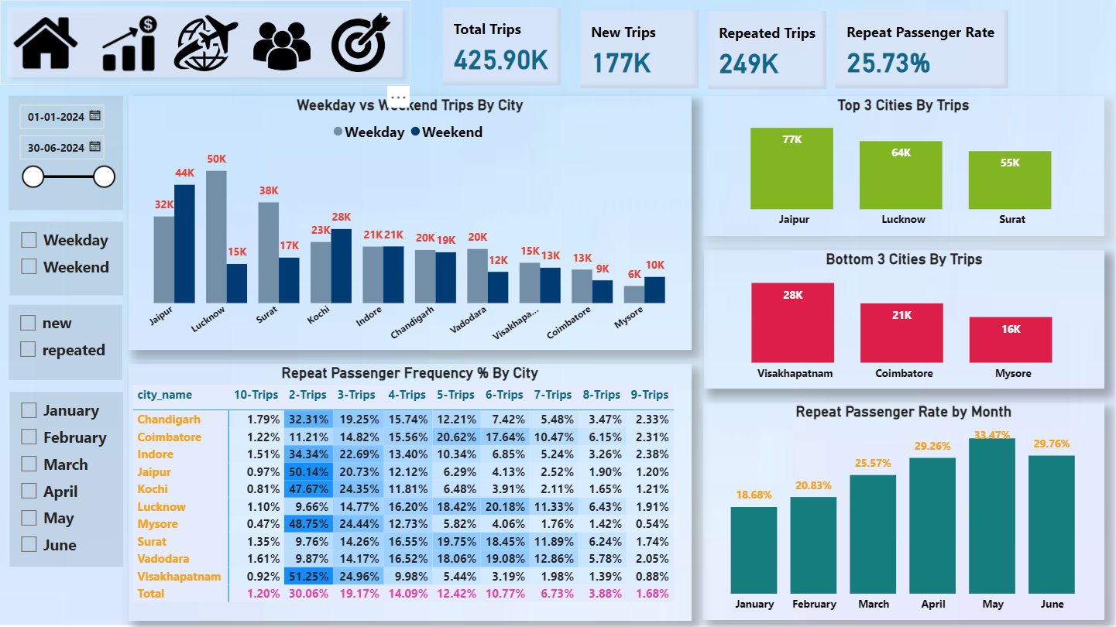
Demand Patterns

Slide 8
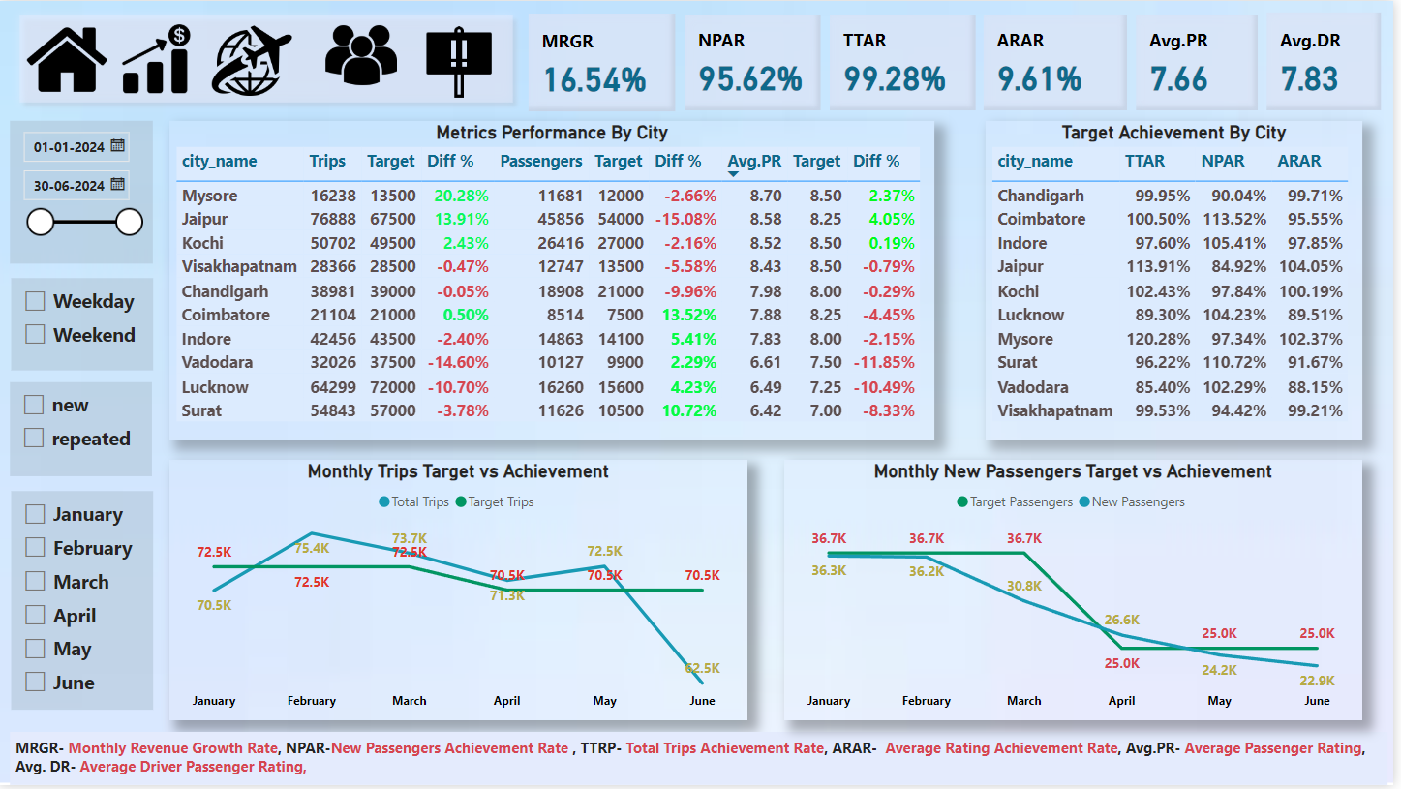
Target Acheivement

Slide 9
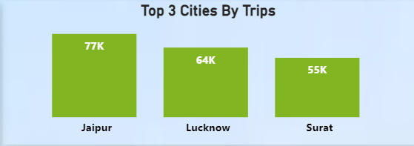
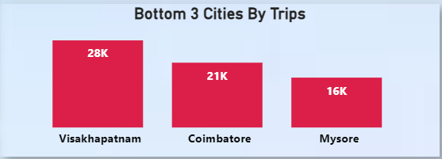
Primary Questions and Insights
1. Top and Bottom Performing Cities
• Identify the top 3 and bottom 3 cities by total trips over the entire analysis period.
INSIGHT
Jaipur, Lucknow, and Surat are the top 3 cities based on total trips, reflecting high demand. It indicates strong tourism activities.
In contrast, Visakhapatnam, Coimbatore, and Mysore have the lowest trip counts, suggesting lower market penetration or service adoption.

Slide 10
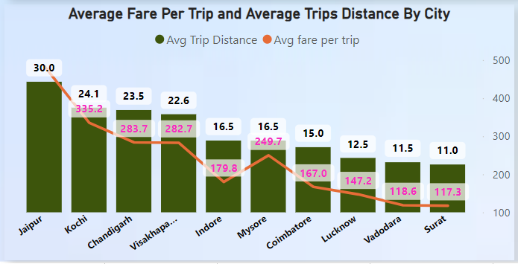
2. Average Fare per Trip by City
Calculate the average fare per trip for each city and compare it with the city's average trip distance. Identify the cities with the highest and lowest average fare per trip to assess pricing efficiency across locations.
INSIGHT
Jaipur has the highest average fare per trip at ₹483.9 with an average trip distance of 30 km, highlighting a pricing strategy that effectively monetizes longer trips. It suggests the city’s pricing strategy aligns well with customer expectations.
Surat and Vadodara, with the lowest average fares of ₹118 and shorter distances of 11 km, present an opportunity to evaluate pricing strategies. The low fares might attract budget-conscious customers .
In Mysore and Indore, despite similar average trip distances of 16.5 KM, the variation in fare pricing underscores potential inefficiencies in revenue generation. Revisiting pricing models in such cases could ensure uniform profitability across cities.

Slide 11
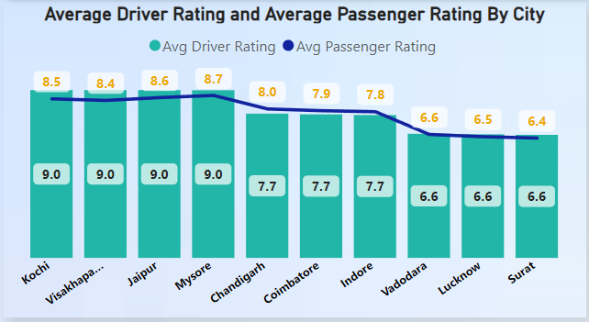
3. Average Ratings by City and Passenger Type
Calculate the average passenger and driver ratings for each city, segmented by passenger type (new vs. repeat). Identify cities with the highest and lowest average ratings.
INSIGHT
Mysore, Jaipur, and Kochi lead in both passenger and driver ratings, with consistent ratings of 9 from new passengers and 8 from repeat passengers. This indicates strong service quality and high customer satisfaction, which can be leveraged for branding and customer retention campaigns.
On the other hand, Surat, Lucknow, and Vadodara display the lowest ratings, with repeated passengers scoring only 6. This signals potential service quality issues. Addressing these gaps through driver training, improved vehicle standards, or incentivizing better service could boost ratings.

Slide 12
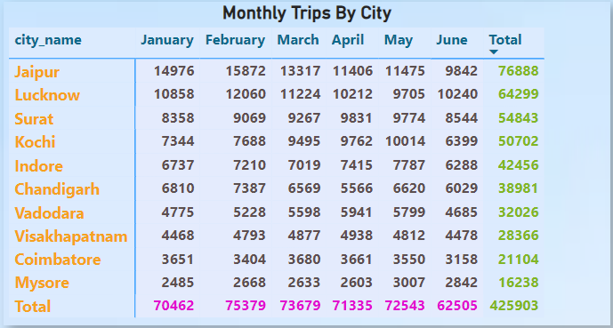
4. Peak and Low Demand Months by City
For each city, identify the month with the highest total trips (peak demand) and the month with the lowest total trips (low demand). This analysis will help Goodcabs understand seasonal patterns and adjust resources accordingly.
INSIGHT
February emerges as the peak month for trips across all cities, particularly Jaipur and Lucknow, highlighting seasonal demand spikes. This trend can guide resource allocation, such as scaling up vehicle availability or driver incentives during high-demand months.
Conversely, a significant drop in trips during June indicates low demand, suggesting an opportunity to introduce off-season promotions or ride discounts to stimulate demand during this period.

Slide 13
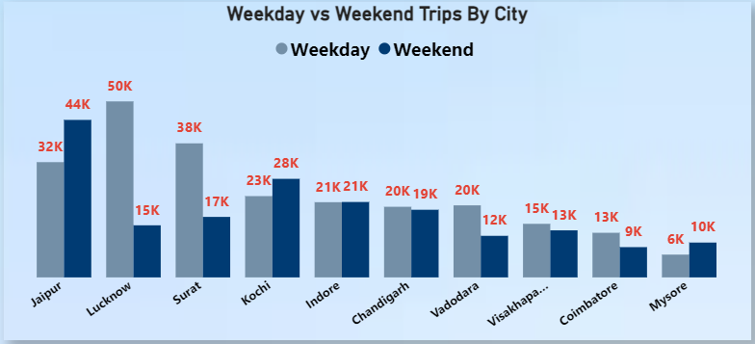
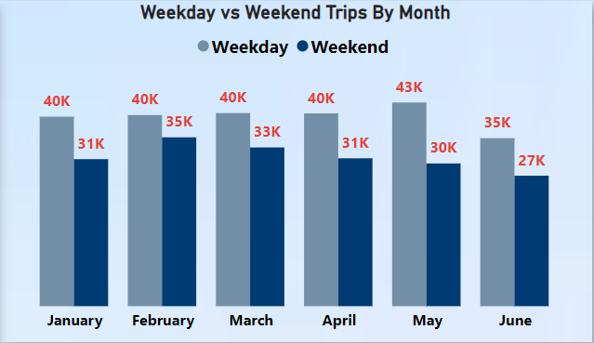
5. Weekend vs. Weekday Trip Demand by City
Compare the total trips taken on weekdays versus weekends for each city over the six-month period. Identify cities with a strong preference for either weekend or weekday trips to understand demand variations.
INSIGHT
Lucknow and Surat exhibit high weekday trip demand, indicating a likely focus on business travel. This insight can inform marketing campaigns targeting corporate clients or daily commuters.
In contrast, Jaipur, Kochi, and Mysore show a preference for weekend trips, pointing to tourism-driven demand. Strengthening partnerships with local tourist agencies or creating weekend packages could help capitalize on this trend.

Slide 14
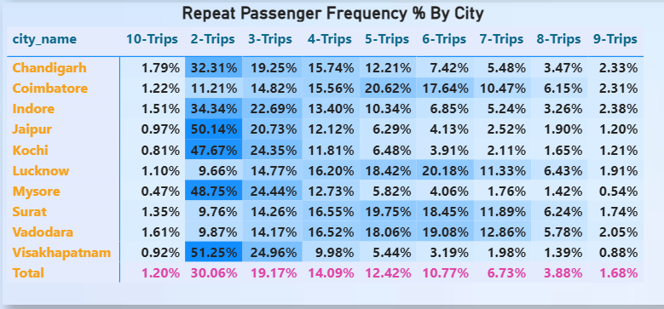
6. Repeat Passenger Frequency and City Contribution Analysis
Analyse the frequency of trips taken by repeat passengers in each city (e.g., % of repeat passengers taking 2 trips, 3 trips, etc.). Identify which cities contribute most to higher trip frequencies among repeat passengers, and examine if there are distinguishable patterns between tourism-focused and business-focused cities.
INSIGHT
Visakhapatnam, Jaipur, and Mysore have the highest percentage of repeat passengers taking two trips, signifying a tourism-oriented market. Tailored offerings, such as discounts for tourists or collaborations with travel agencies, could enhance these patterns.
Surat, Vadodara, and Lucknow, with higher frequencies of 4–6 trips, suggest a business-driven market. Focusing on loyalty programs or corporate tie-ups in these cities could further drive repeat trips.

Slide 15
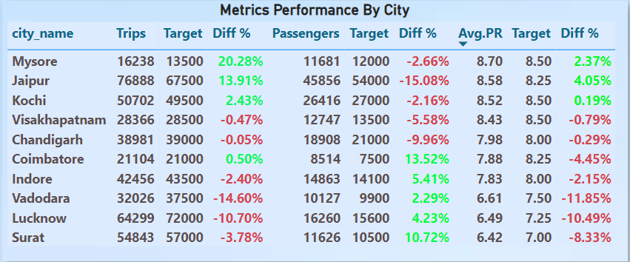
7. Monthly Target Achievement Analysis for Key Metrics
For each city, evaluate monthly performance against targets for total trips, new passengers, and average passenger ratings from targets_db. Determine if each metric met, exceeded, or missed the target, and calculate the percentage difference. Identify any consistent patterns in target achievement, particularly across tourism versus business-focused cities.
INSIGHT
Mysore and Jaipur significantly exceeded target trips during January and February, showcasing their potential for further investment and resource allocation during peak seasons.
Coimbatore and Surat excelled in new passenger targets, particularly in January and February, indicating strong marketing efforts or effective onboarding strategies in these months.
Jaipur failed to meet new passenger targets, signaling a need to refine customer acquisition strategies or address potential barriers like competition or limited promotions.

Slide 16
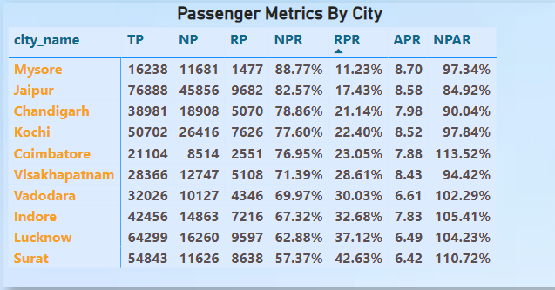
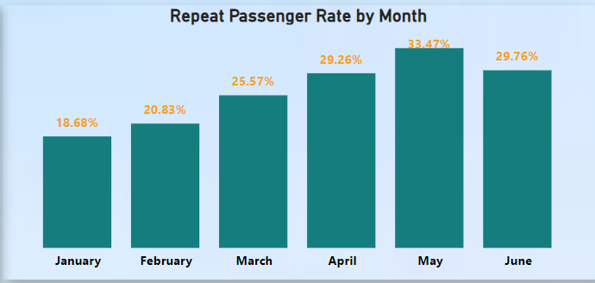
8. Highest and Lowest Repeat Passenger Rate (RPR%) by City and Month
INSIGHT
Surat and Lucknow rank highest in Repeat Passenger Rates (RPR%), underscoring strong customer loyalty. These cities could benefit from the implementation of advanced loyalty programs or exclusive deals for frequent riders.
Mysore and Jaipur have the lowest RPR%, highlighting a need to address service quality or customer engagement strategies to improve loyalty.
May records the highest RPR%, suggesting enhanced customer satisfaction during this month. Conversely, January’s low RPR% points to opportunities for seasonal campaigns or improved service engagement to boost loyalty at the start of the year.

Slide 17
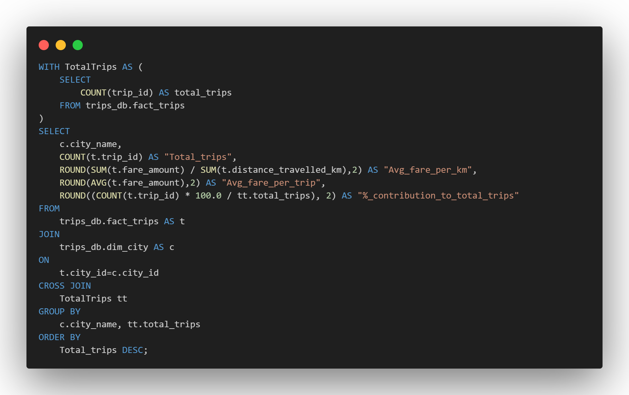
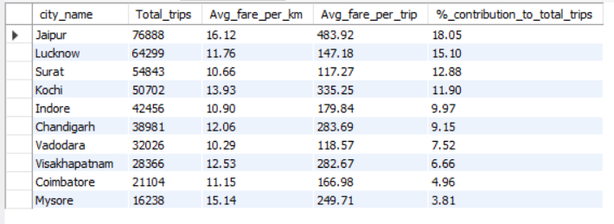
Ad-Hoc Reports
Business Request-1:City-Level Fare and Trip Summary Report

Slide 18
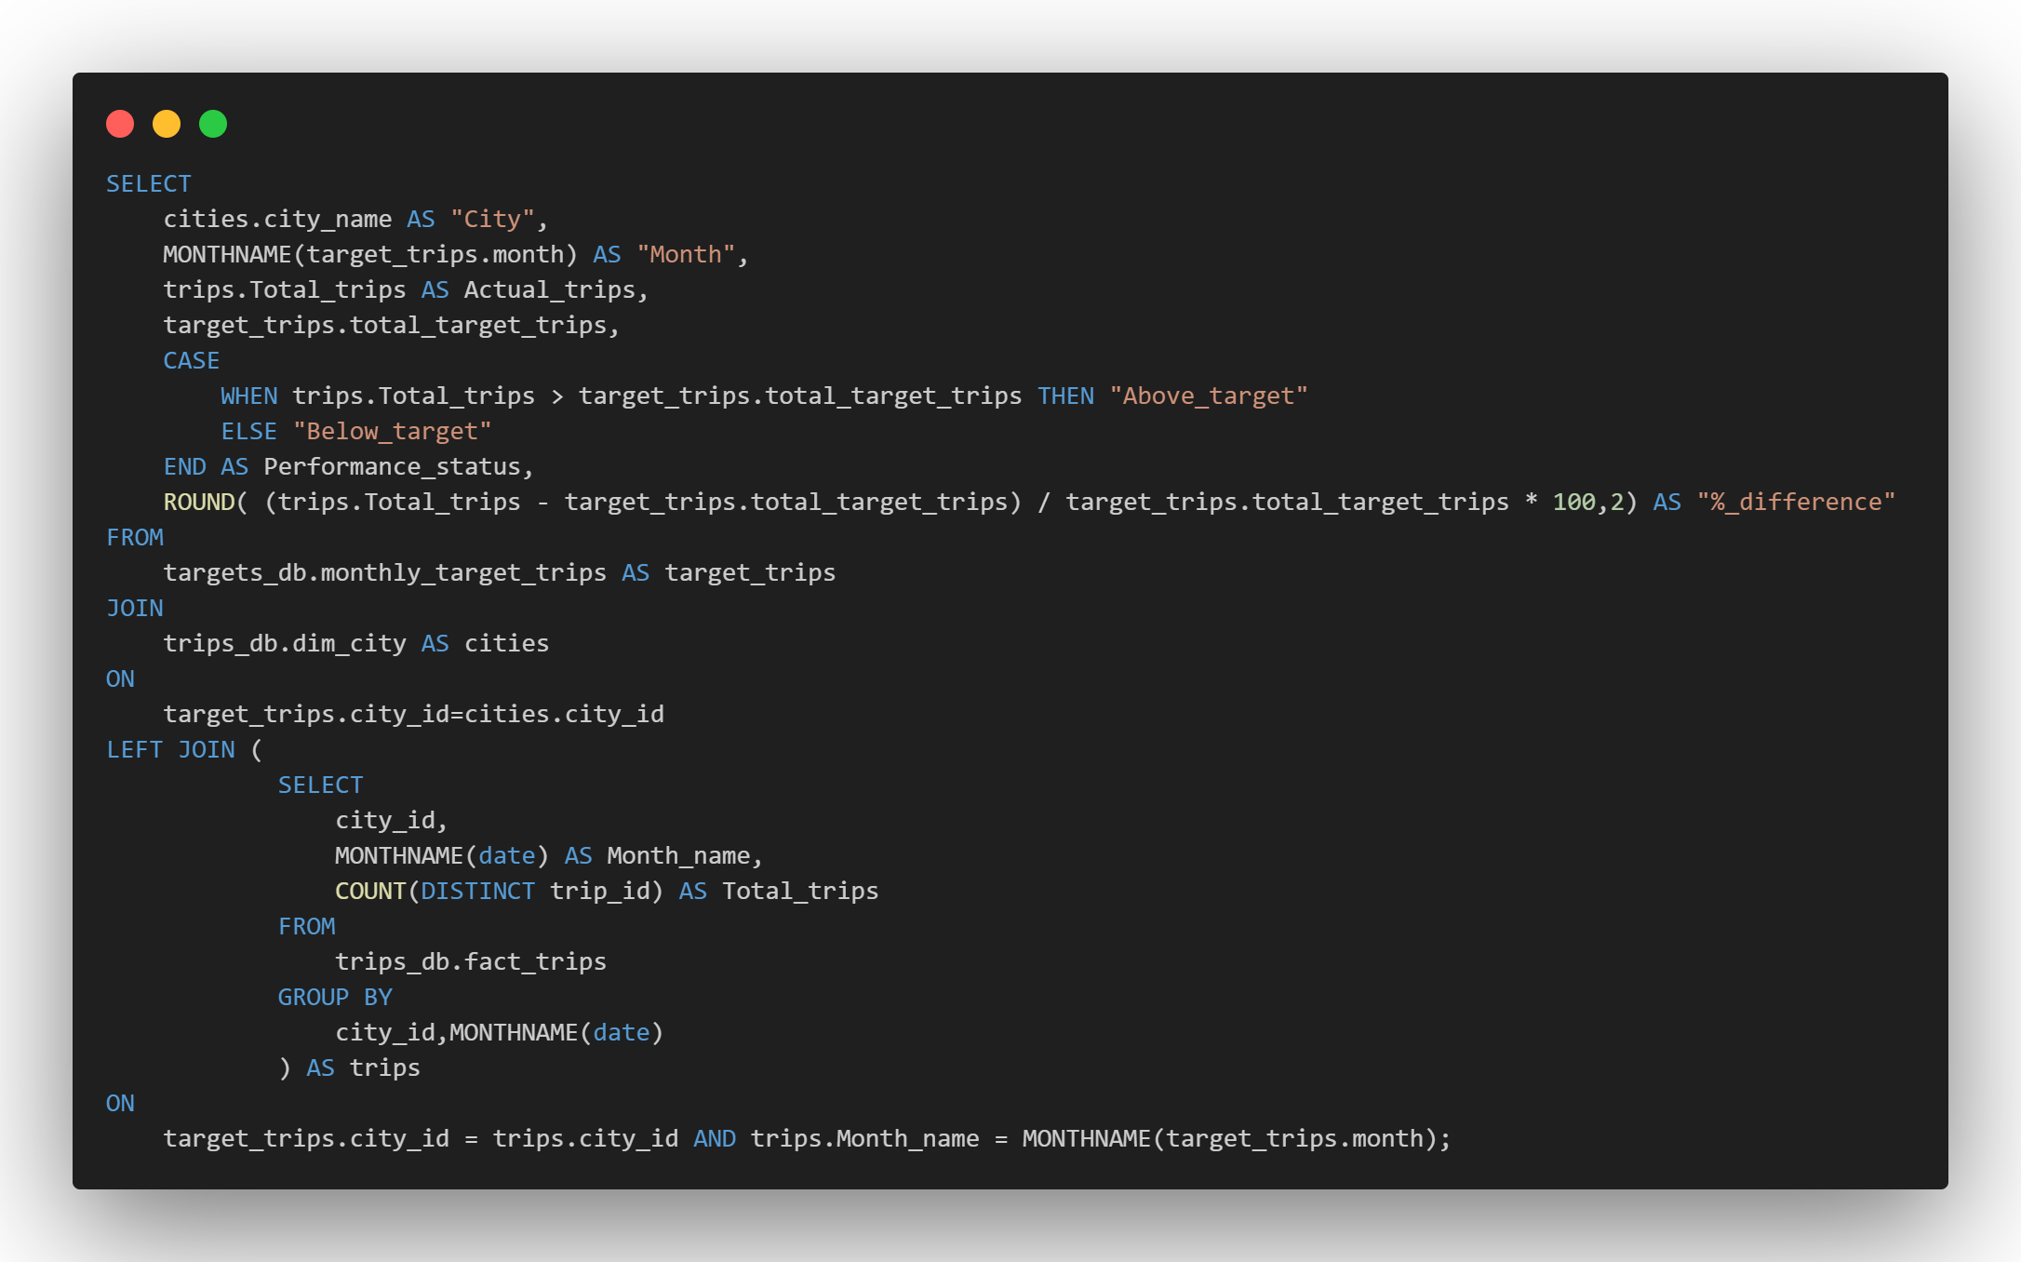
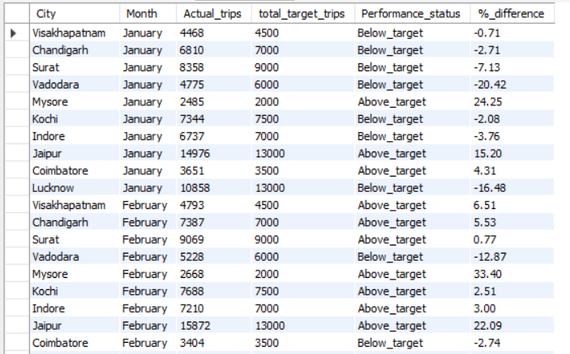
Ad-Hoc Reports
Business Request-2:Monthly City-Level Trips Target Performance Report

Slide 19
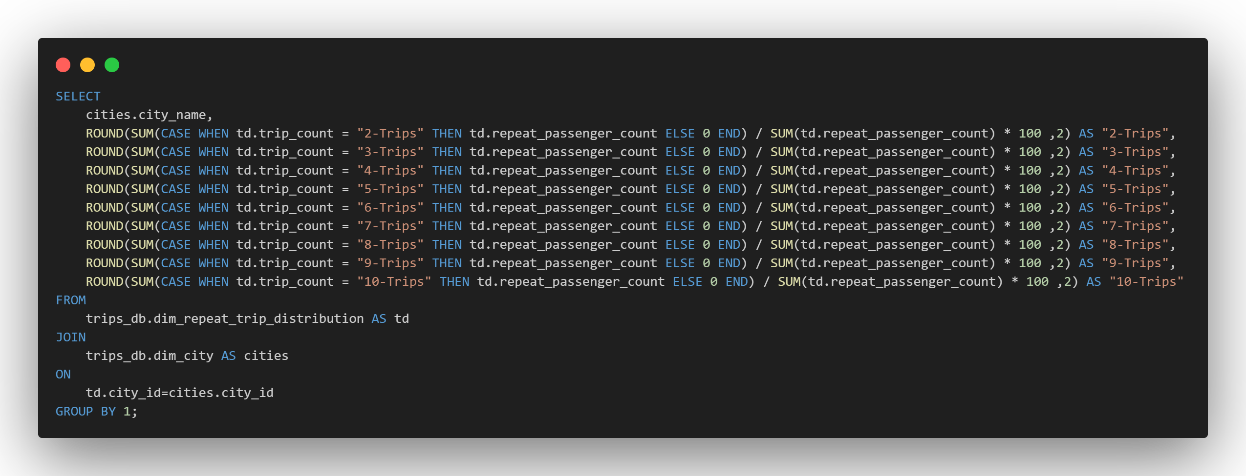
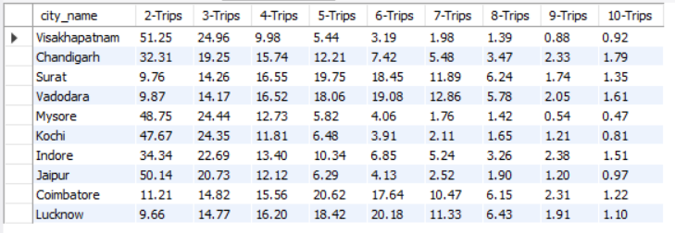
Ad-Hoc Reports
Business Request-3: City-Level Repeat Passenger Trip Frequent Report

Slide 20
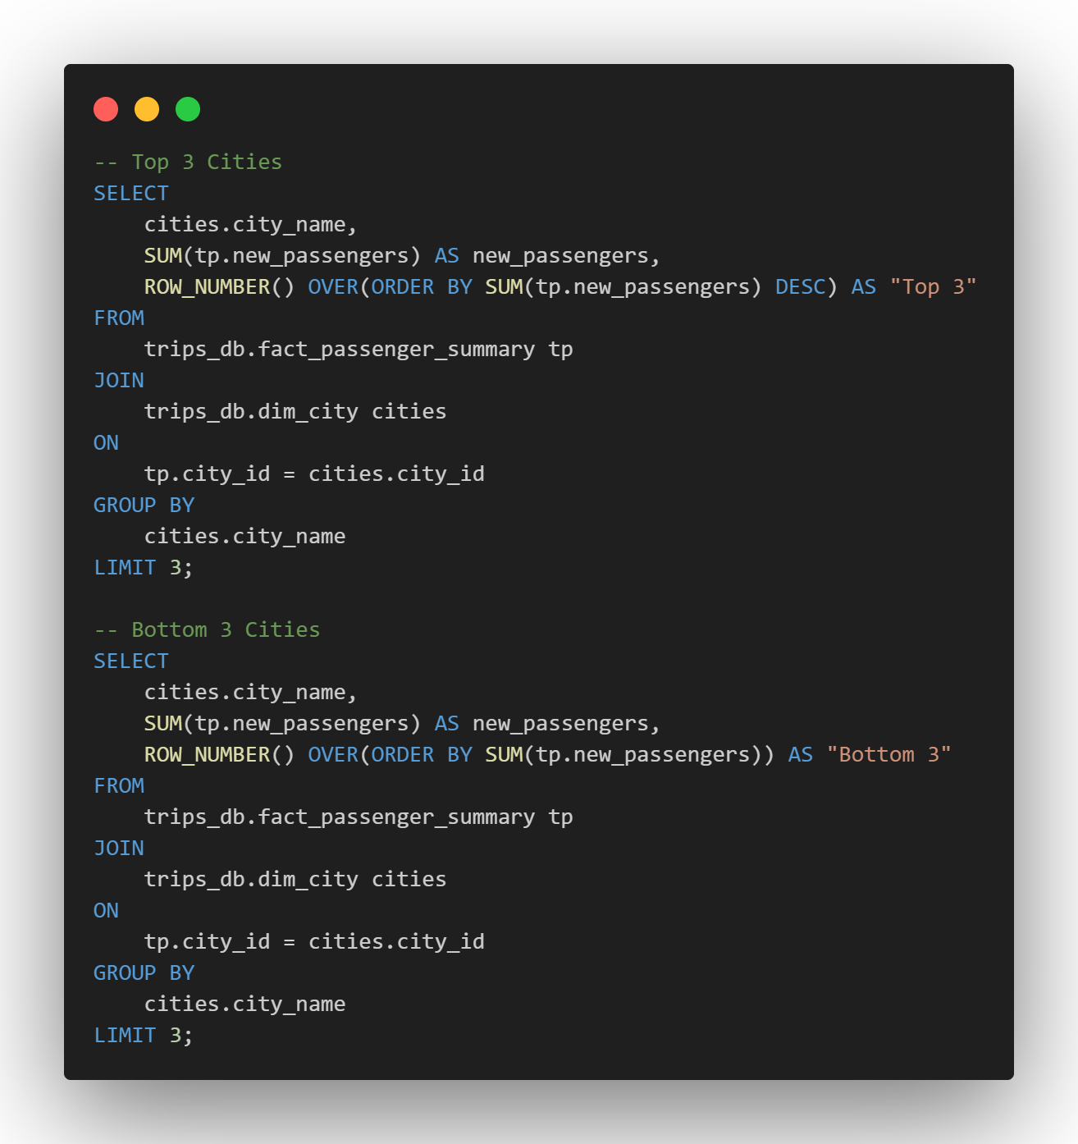
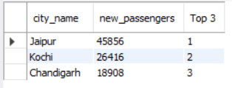
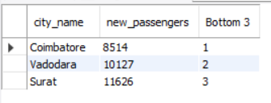
Ad-Hoc Reports
Business Request-4: Identify the Cities with Highest and Lowest New Passengers

Slide 21
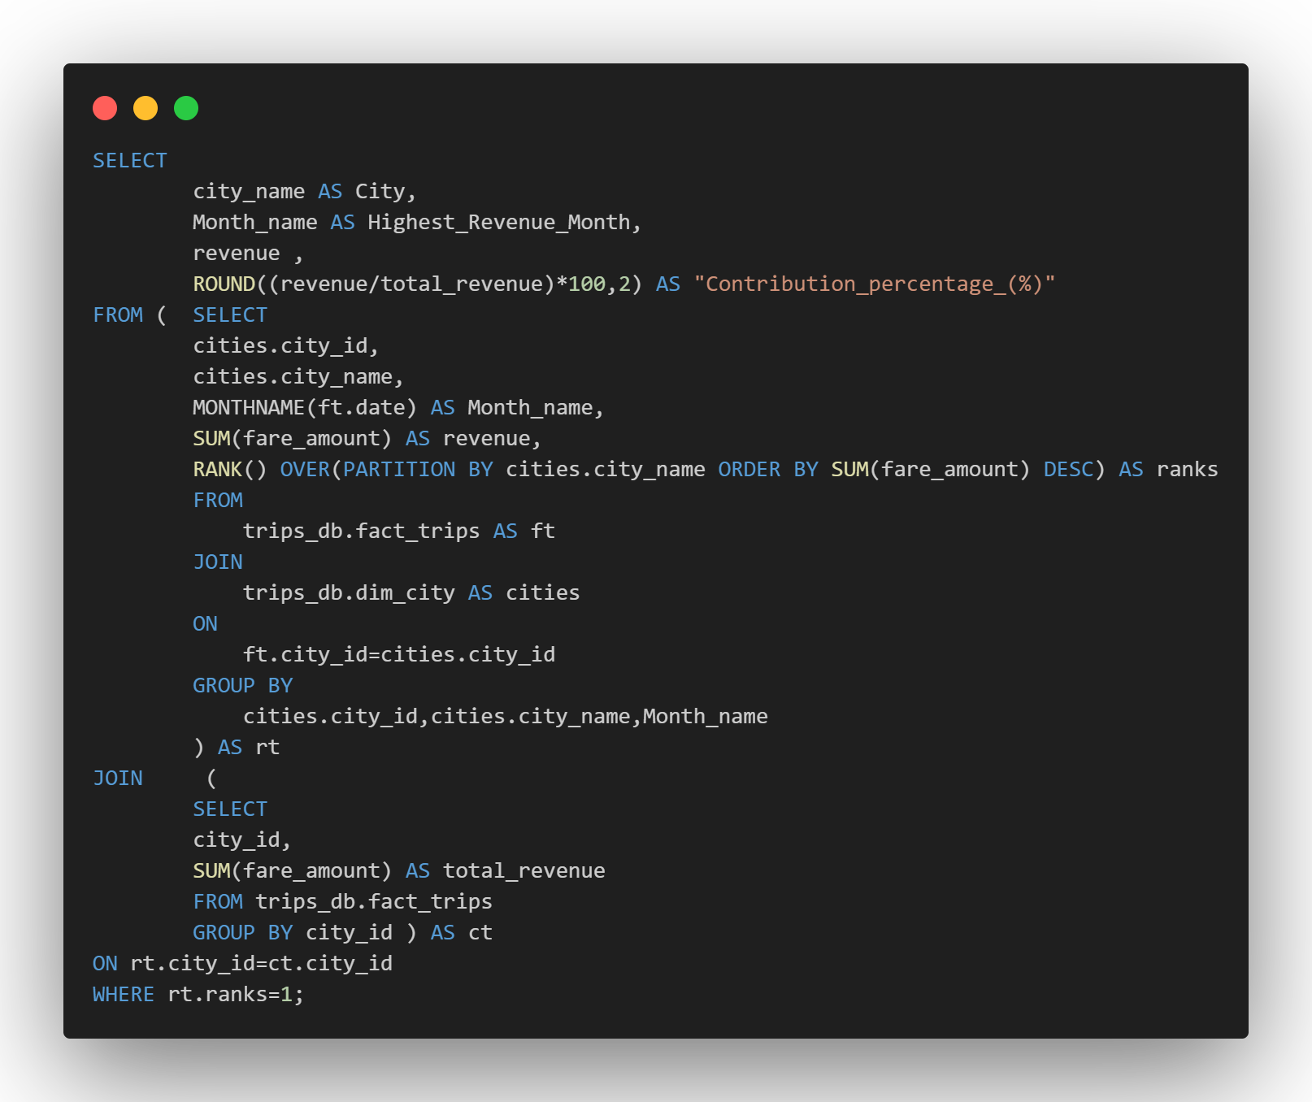
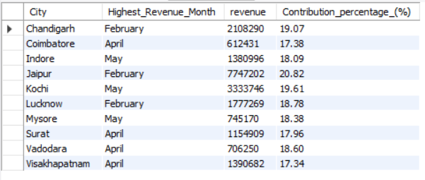
Ad-Hoc Reports
Business Request-5: Identify Month with Highest Revenue for each city

Slide 22
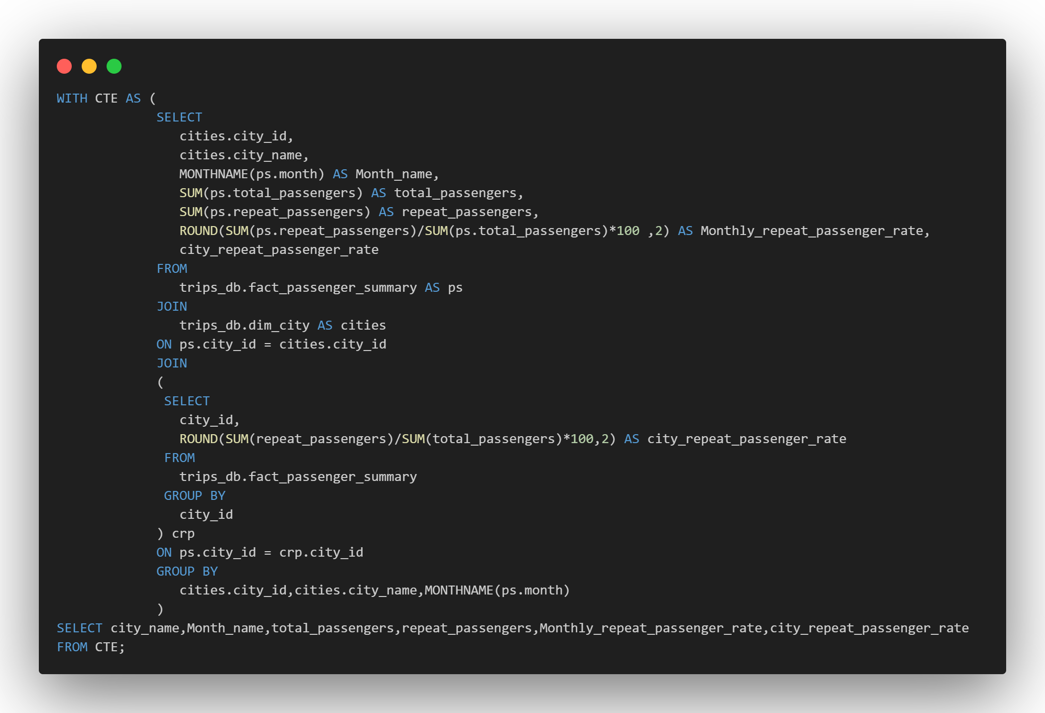
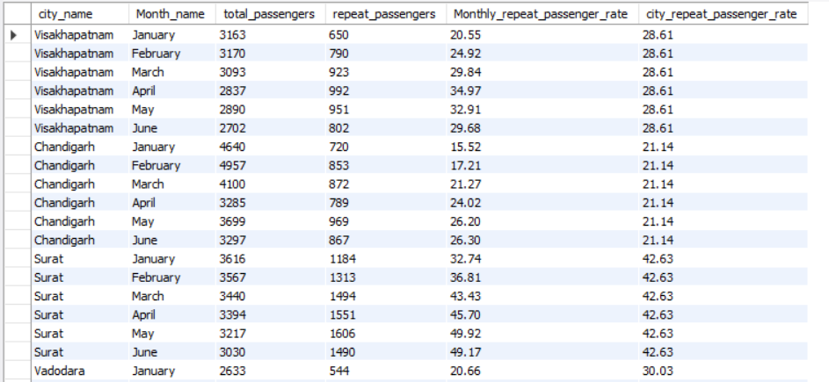
Ad-Hoc Reports
Business Request-6: Repeat Passenger Rate Analysis

Slide 23
SECONDARY ANALYSIS
1. Factors Influencing Repeat Passenger Rates
What factors (such as quality of service, competitive pricing, or city demographics) might contribute to higher or lower repeat passenger rates in different cities? Are there correlations with socioeconomic or lifestyle patterns in these cities?
Quality of Service: Cities with higher ratings (e.g., Mysore and Jaipur) often correlate with higher customer satisfaction. Investing in driver training, vehicle maintenance, and ensuring punctuality could elevate repeat passenger rates in underperforming cities.
Competitive Pricing: Ensure that pricing aligns with customer expectations while maintaining profitability. Variations between cities (e.g., Mysore and Indore) suggest the need for localized pricing strategies.
City Demographics and Lifestyle Patterns:
Socioeconomic factors: Cities with higher disposable income or a younger demographic (e.g., business hubs like Lucknow) may exhibit greater repeat passenger rates due to frequent commuting needs.
Cultural preferences: Tourism-focused cities like Jaipur and Kochi may have irregular patterns, influenced by seasonal tourist influx. A tailored approach during peak seasons could improve loyalty.

Slide 24
2. Tourism vs. Business Demand Impact
How do tourism seasons or local events (festivals, conferences) impact Goodcabs' demand patterns? Would tailoring marketing efforts to these events increase trip volume in tourism-oriented cities?
Leverage Tourism Seasons: Design promotional campaigns around festivals or events. For instance, Jaipur’s peak demand in February could be further amplified by collaborations with tourist agencies or discounted family packages.
Target Business Clients: For cities like Lucknow and Surat, which display higher weekday demand, corporate tie-ups and business commuter packages could drive sustained growth.
Event-based Marketing: Identify key local events (e.g., fairs, conferences, or exhibitions) and offer tailored services such as shuttles, group discounts, or premium rides.

Slide 25
3. Emerging Mobility Trends and Goodcabs' Adaptation
• What emerging mobility trends (such as electric vehicle adoption, green energy use) are impacting the cab service market in tier-2 cities? Should Goodcabs consider integrating electric vehicles or eco-friendly initiatives to stay competitive?
Electric Vehicle (EV) Integration:
Introduce a pilot fleet of EVs in environmentally conscious cities or those with government incentives for green mobility.
Highlight eco-friendly rides to attract environmentally aware customers.
Sustainability Initiatives: Offer carbon offset options or discounts for shared rides to appeal to green-conscious passengers.
Tech Adoption: Integrate real-time trip tracking, enhanced app features, or digital payment options to align with growing tech-savvy customer expectations.
Government Collaboration: Partner with local governments to align with smart city projects or EV subsidy programs.

Slide 26
4. Partnership Opportunities with Local Businesses
Are there opportunities for Goodcabs to partner with local businesses (such as hotels, malls, or event venues) to boost demand and improve customer loyalty? Could these partnerships drive more traffic, especially in tourism- heavy or high-footfall areas?
Tourism-oriented Cities: Partner with hotels, tour operators, and airports in cities like Jaipur and Kochi to create bundled offerings (e.g., cab + hotel discounts).
High-footfall Areas: Establish partnerships with malls, event venues, or corporate hubs to offer exclusive ride discounts or parking promotions.
Promotional Alliances: Collaborate with local festivals or events (e.g., Jaipur Literature Festival) for sponsored rides or priority booking options.
Loyalty Incentives: Co-develop reward programs with local businesses where customers earn benefits (e.g., hotel vouchers or mall discounts) for repeated rides.

Slide 27
5. Data Collection for Enhanced Data-Driven Decisions
To make Goodcabs more data-driven and improve its performance across key metrics (such as repeat passenger rate, customer satisfaction, new passengers and trip volume), what additional data should Goodcabs collect? Consider data that could provide deeper insights into customer behaviour, operational efficiency, and market trends.
Customer Behavior Information:
Collect granular data on passenger preferences, such as trip purpose (tourism, business) and booking time (advance vs. last-minute) and reason for cancellation to identify bottle necks.
Feedback and survey data on service quality and pricing perception.
Operational Efficiency:
Monitor real-time metrics on driver performance, vehicle utilization, and maintenance schedules.
Analyze trip cancellations and delays for process improvements.
Market Trends:
Integrate external data sources like weather patterns, local event schedules, and competitor pricing.
Track EV adoption rates and regulatory changes in tier-2 cities.
Tech Usage:
Implement a data management platform that consolidates all metrics and provides predictive analytics for demand forecasting and service optimization.

Slide 28
RECOMMENDATIONS
Enhance Service Quality in Low-Performing Cities
Focus on improving driver training, vehicle maintenance, and customer experience in Visakhapatnam, Coimbatore, and Mysore, where total trips are the lowest.
Implement feedback-driven service enhancements in Surat, Lucknow, and Vadodara, where customer satisfaction ratings are low.
Refine Pricing Strategies Across Cities
Adjust fares in cities like Mysore and Indore, where fare efficiency varies despite similar average trip distances.
Introduce competitive pricing for cities with low average fares per trip (e.g., Vadodara and Surat) to boost demand and align pricing with customer expectations.
Capitalize on Seasonal Trends and Demand Variations
Allocate additional resources and drivers to cities like Jaipur and Lucknow during peak demand months (February–April) to accommodate the seasonal surge.
Develop promotional campaigns for June, focusing on discounts or loyalty rewards to mitigate low demand.
Targeted Marketing and Packages for Tourism and Business Cities
Offer tourism-specific packages (e.g., discounted multi-day passes) in cities like Visakhapatnam, Jaipur, and Kochi, where trips are tourism-driven.
Develop corporate tie-ups and commuter-friendly packages for business hubs like Surat, Vadodara, and Lucknow, where repeat passengers take frequent trips.
Boost Repeat Passenger Loyalty and Target Achievement Rates
Enhance loyalty programs in cities with low RPR% (e.g., Mysore and Jaipur) to incentivize repeat bookings.
Provide targeted promotions to improve metrics in underperforming cities like Vadodara and Lucknow, particularly for trips and new passenger acquisition.

Slide 29
THANK YOU

